Slide 1



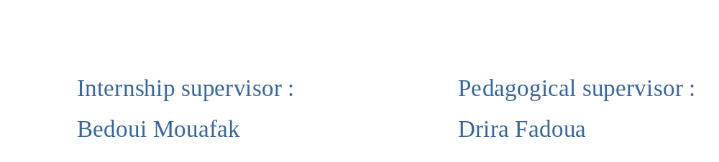
NETWORK TRAFFIC ANOMALY DETECTION

Slide 2

Plan
Tunisian Chemical Group
Network Traffic Anomaly Detection
  Concept
  Objective
  Machine Learning
    K Nearest Neighbor
    K Means
  Methodology
Conclusion

Slide 3

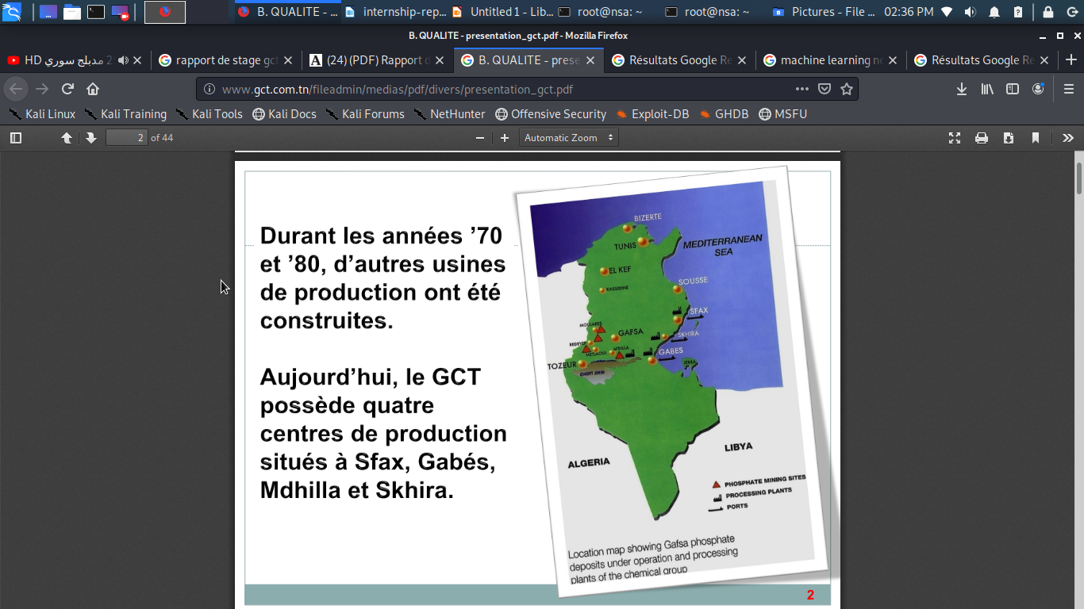
Tunisian Chemical Group
The Tunisian Chemical Group (GCT) is a Tunisian public company whose purpose is to transform phosphate extracted in Tunisia into chemicals such as phosphoric acid or fertilizers.
This company has 4 industrial phosphate processing sites located in Sfax and Mdhilla (for TSP production), in Gabes (for the production of Phosphoric Acid, DAP, DCP and AN) and Skhira (for the production of Phosphoric Acid).
Currently, the Ghannouch Industrial Zone (Gabes) is home to the GCT's largest production platform.

Slide 4
Computer Division of Gabes
The computer division of Gabes is modernizing and deploying the information system in the GCT and especially the different sites in the region of Gabes : improving its productivity, managing interconnections, optimizing and securing the system.
This division is composed of three services : the Office service, the Application Administration service and the IT Center service.
Among the tasks carried out by the DI of Gabes, we can mention:
Ensure the operation, in the best conditions, of the hardware and software park
Ensure the purchase of computer equipment and software.
Supervise the infrastructure of computer networks and guarantee their operation and their security.
Ensure the hierarchical supervision of all IT teams.
Manage subcontracting: call for tenders, choice of service providers, management

Slide 5
Network Traffic Anomaly Detection

Slide 6
Concept
Our work focuses on the analysis of the historical network traffic data to identify network usage trends and security vulnerabilities. In doing so ,the data analytic , machine-learning tools and algorithms, such as Kmeans and Knn algorithms ,were utilized to assess Cybersecurity risk and identify baseline network behavior in order to detect abnormal patterns in network traffic.
Cybersecurity is a growing research area with direct commercial impact to organizations and companies in every industry.
In this project we discuss a framework that can predict Cybersecurity risk by identifying normal network behavior and detect network traffic anomalies.

Slide 7
Objective
The goal of this project is to :
generate a Data_set that fit the topic and deal with,
analyze, detect and predict existing and emerging threats, network behaviors and alerting mechanisms while applying Knn and Kmeans clustering algorithms to a data_set.

Slide 8
Machine Learning
Machine learning is a method of data analysis that automates analytical model building. Using algorithms that iteratively learn from data ,ML allows computers to find hidden insights without being explicitly programmed where to look. There are 3 main types of ML algorithms :
- Supervised learning models are used when we have labeled data and are trying to predict a label based off of known features.
- Unsupervised learning models are used when we only have the input variables (X) and no corresponding output variables.
- Reinforcement learning is a type of machine learning algorithm that allows an agent to decide the best next action based on its current state by learning behaviors that will maximize a reward.

Slide 9
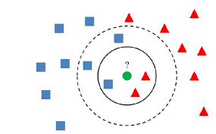
K Nearest Neighbor
The K-Nearest Neighbors algorithm uses the entire data set as the training set, rather than splitting the data set into a training set and test set. The case being assigned to the class is most common amongst its K nearest neighbors measured by a distance function. These distance functions can be Euclidean, Manhattan, Minkowski and Hamming distance. If K = 1, then the case is simply assigned to the class of its nearest neighbor. At times, choosing K turns out to be a challenge while performing kNN modeling. In our case we will find out that the best K is 34 .

Slide 10
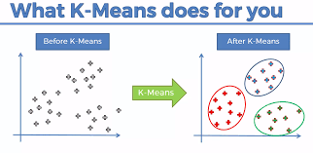
K Means
K-means is an iterative algorithm that groups similar data into clusters.It calculates the centroids of k clusters and assigns a data point to that cluster having least distance between its centroid and the data point. Here, let us say k = 2 , we define 2 clusters ‘normal” and ‘malicious’. After, we randomly assign each observation to a cluster, and finds the centroid of each cluster.Then, the algorithm iterates through two steps: Reassign data points to the cluster whose centroid is closest. Calculate new centroid of each cluster.These two steps are repeated till the within cluster variation cannot be reduced any further. The within cluster variation is calculated as the sum of the euclidean distance between the data points and their respective cluster centroids.

Slide 11
Methodology
wireshark
Tranalyzer
Jupyter-python-
Machine
Learning
snif3.pcapng
file_flows.csv
1.Cleaning the dataset
2Dealing with the tcp anomalies
3.Analyze
4.Detect
5.Predict

Slide 12
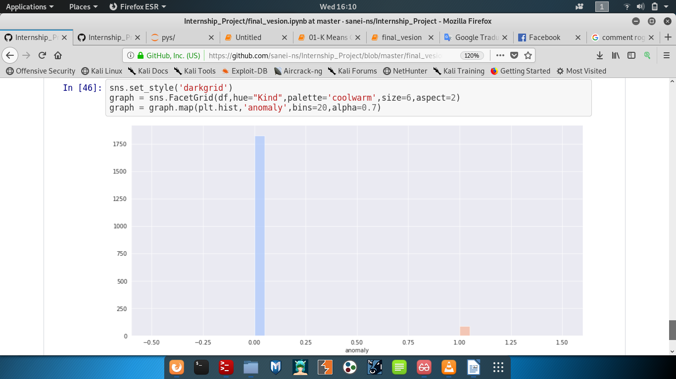
Conclusion
As a result, we found out that 96% of the sniffed GCT network traffic are considered as normal network behaviors while 4% were considered as malicious anomalies.
The results obtained so far show that, with simple heuristics, the most immediate positive result is a better knowledge of the functioning of the network and that trivial anomalies are easily identifiable.

Slide 13

Thanks For Your Attention

